Slide 1
Measurement of Temperature Using Thermistor

Slide 2
What is a Thermistor?
A thermistor (or thermal resistor) is defined as a type of resistor whose electrical resistance varies with changes in temperature.
Although in all resistors, resistance will fluctuate slightly with temperature, a thermistor is particularly sensitive to temperature changes.
Thermistors act as a passive component in a circuit. They are an accurate, cheap, and robust way to measure temperature.
Thermistors are of two types
Negative Temperature Coefficient(NTC)
Positive Temperature Coefficient(PTC)

Slide 3
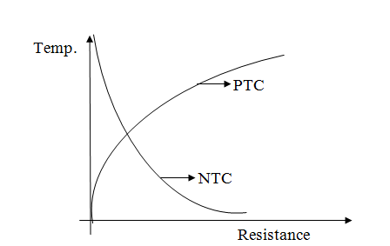
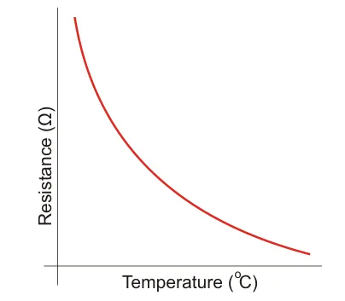
Use of Thermistors

Slide 4
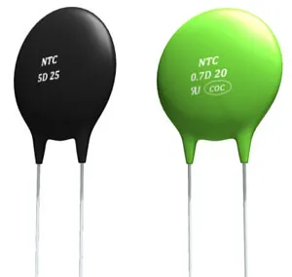
Use of Thermistors

Slide 5

Use of Thermistors

Slide 6
Use of Thermistors
Digital thermometers (thermostats)
Automotive applications (to measure oil and coolant temperatures in cars & trucks)
Household appliances (like microwaves, fridges, and ovens)
Circuit protection (i.e. surge protection)
Rechargeable batteries (ensure the correct battery temperature is maintained)
To measure the thermal conductivity of electrical materials
Useful in many basic electronic circuits (e.g. as part of a beginner Arduino starter kit)
Temperature compensation (i.e. maintain resistance to compensate for effects caused by changes in temperature in another part of the circuit)
Healthcare and Patient Monitoring

Slide 7
Use of Thermistors
Temperature compensation
Temperature Control
Provision of Time Delay

Slide 8
Advantages of Thermistors
Fast response over narrow temperature range
Small in size
Contact and Lead resistance problem does not occur because of large resistance
Good sensitivity in NTC region
Low Cost

Slide 9
Disadvantages of Thermistors
Thermistor needs shielding power line
The excitation current should be low to prevent self heating
It is not suitable for large temperature range
The resistance temperature characteristics are non linear.

